Slide 1
TANGIBLE USER INTERFACE
BHAVNA
ELMO
MOHAMMED
FAIZA
AISHA

Slide 2
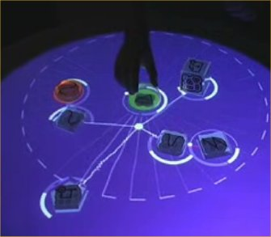
CONCEPT OF TUI

Slide 3
DEFINITION
“A tangible user interface is one in which the user interacts with a digital
system through the manipulation of
physical objects linked to and directly
representing a quality of said system.

Slide 4
CHARACTERISTICS OF TANGIBLE USER INTERFACE
Physical representations are computationally coupled to underlying digital information.
Physical representations embody mechanisms for interactive control.
Physical representations are perceptually coupled to actively mediated digital representations.
Physical state of tangibles embodies key aspects of the digital state of a system

Slide 5
MAIN OBJECTIVE OF TUI
The idea with TUIs is to have a direct link
between the system and the way you
control it through physical manipulations
by having an underlying meaning or direct
relationship which connects the physical
manipulations to the behaviours which
they trigger on the system.

Slide 6
CONCEPT OF THE GAME
To develop a game that allows the children to try different styles of designing a room.
TARGET USERS
Children between 6 – 12 years

Slide 7




FIDUCIALS

Slide 8
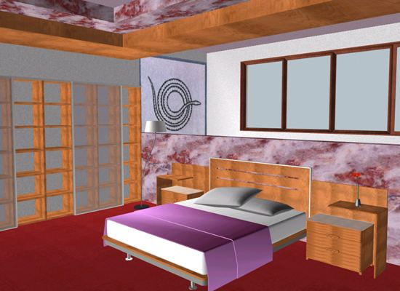
SCREENSHOT OF THE GAME

Slide 9
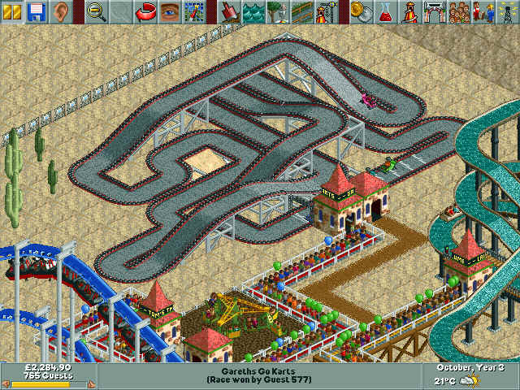

Slide 10
HOW IS THE GAME?
IT IS ENGAGING & FUN - KEEPS THE USER INVOLVED AT ALL LEVELS.
EDUCATIONAL – HELPS THE USER ENHANCE THE SKILLS IN PERCEIVING THE CONCEPT IN DESIGNING, IMPROVES LOGIC & EDUCATES THEM ABOUT SAFETY.
THE AUDIO & VISUAL FEEDBACK HELPS THE USER TO INTERACT AND VALIDATE THE STEPS TAKEN TO PERFORM VARIOUS TASKS

Slide 11
CHILDREN ARE TECH SAVVY
Children play in many different ways according to their own interests and abilities,
They enjoy different forms of play at different times and places.

